Slide 1
Optimizing Algorithm's Performance: Tips for Beginners
Simran Bansal
queries@sibansal.dev

Slide 2
Contents
Introduction to Algorithms
Understanding Algorithm Performance
Performance analysis in runtime
Levels of Algorithm optimization
Open Discussion
Session Wrap-up

Slide 3
Introduction to Algorithms
A combination of finite set of unambiguous instructions used to solve a potential problem under deterministic time constraint.
An algorithm is independent of programming languages.
An algorithm must produce at least one output.

Slide 4
Checklist for an Algorithm
Finiteness
Correctness
Feasible
Independent
Produces Output

Slide 5
Write an algorithm
Algorithm: Add Two Numbers
Input: Two integers num1 and num2
Output: The sum of num1 and num2
Start
Read num1 and num2 from input
Set sum = num1 + num2
Return sum as the result
Stop

Slide 6
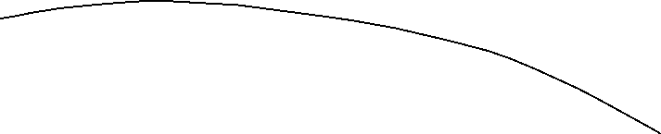
Write an algorithm
Algorithm: Power Of Two Numbers
Input: Two integers base (a) and exponent (b)
Output: The result of a raised to the power of b
Start
Read base (a) and exponent (b) from input
Set result = 1
If b is 0, return 1 (Any number raised to the power of 0 is 1)
If b is negative, set base = 1 / base and exponent = -exponent
While exponent is greater than 0:
a. If exponent is odd, multiply result by base
b. Set base = base * base
c. Set exponent = exponent / 2 (integer division)
Return result
Stop

Slide 7
Points to consider
Time
Space

Slide 8
Points to consider
A posteriori (Post Program)
A priori (Pre-Program)
Language Dependent
Exact answers
Different answers
Relative analysis
Language Independent
Approx Answers
Unique Answers
Absolute Answers

Slide 9
Points to consider
Focus on loops
Focus on proof first then examples
Difficult simplification -> Take large conditions

Slide 10

Asymptotic Analysis
DESMOS Live Demo
Big O:
$$f\left(n\right)=O\left(g\left(n\right)\right) iff f\left(n\right)≤c.g\left(n\right)∀n>n_{o} ∃ 2constants: c_{o}, n_{o}≥1$$
Big Omega:
$$f\left(n\right)=Ω\left(g\left(n\right)\right) iff f\left(n\right)≥c.g\left(n\right)∀n>n_{o} ∃ 2constants: c_{o}, n_{o}≥1$$
Big Theta:
$$f\left(n\right)=θ\left(g\left(n\right)\right) iff f\left(n\right)≤c_{1}.g\left(n\right)$$
$$f\left(n\right)≥c_{2}.g\left(n\right) ∀n>n_{o} ∃ 2 constants: c_{1},c_{2}, n_{o}≥1$$

Slide 11
Demo 1: A Priori Analysis
Jupiter Notebook 1.1
Bublesort
Binary Search
Linear Search

Slide 12
Demo 2: A Posteriori Analysis
Jupiter Notebook 1.2
Inefficient loops
Redundant calculations
Excessive memory usage

Slide 13
Profiling
Purpose: Profiling is used to identify where time is being spent in the code and to identify performance bottlenecks.
Method: Profiling instruments the code to gather data on the execution time of various functions, methods, or lines of code. It provides insights into which parts of the code are consuming the most time.
Output: Profiling typically generates a report showing the time spent in each function or method, the number of times each function or method was called, and other relevant information.

Slide 14
Benchmarking
Purpose: Benchmarking is used to measure the overall performance or execution time of a piece of code or system under specific conditions.
Method: Benchmarking involves running the code multiple times under controlled conditions and measuring the execution time or other relevant metrics.
Output: Benchmarking typically provides a single metric, such as average execution time, throughput, or latency, which can be used to compare different implementations or configurations.

Slide 15
Factors affecting performance
Jupiter Notebook 1.3
Time complexity
Space complexity
Choice of data structures
Algorithm design paradigm
Characteristics of input data

Slide 16
Factors affecting performance
Jupiter Notebook 1.3
Hardware and environment
Optimizations and heuristics
Implementation details
External dependencies
Randomness and non-determinism

Slide 17
Master Theorem
Article Reference
Helps figure out how long recursive algorithms take to run.
Makes it easier to deal with patterns in equations we see a lot in computer science.
Sorts these patterns into different groups.
Gives a clear way to estimate how fast recursive algorithms grow.
Makes it simpler to understand and solve time-related problems in computer science.

Slide 18
What’s next?
Coding Ninja Learning Path
Google Learning Path
Free Code Camp
Data Structure and Algorithmic Thinking with Python by Narasimha Karumanchi
Guide to Competitive Programming by Antti Laaksonen
* Shared links are not sponsored by any means; Amazon affiliated links are used for mentioned reference books.

Slide 19

Open Discussion

Slide 20
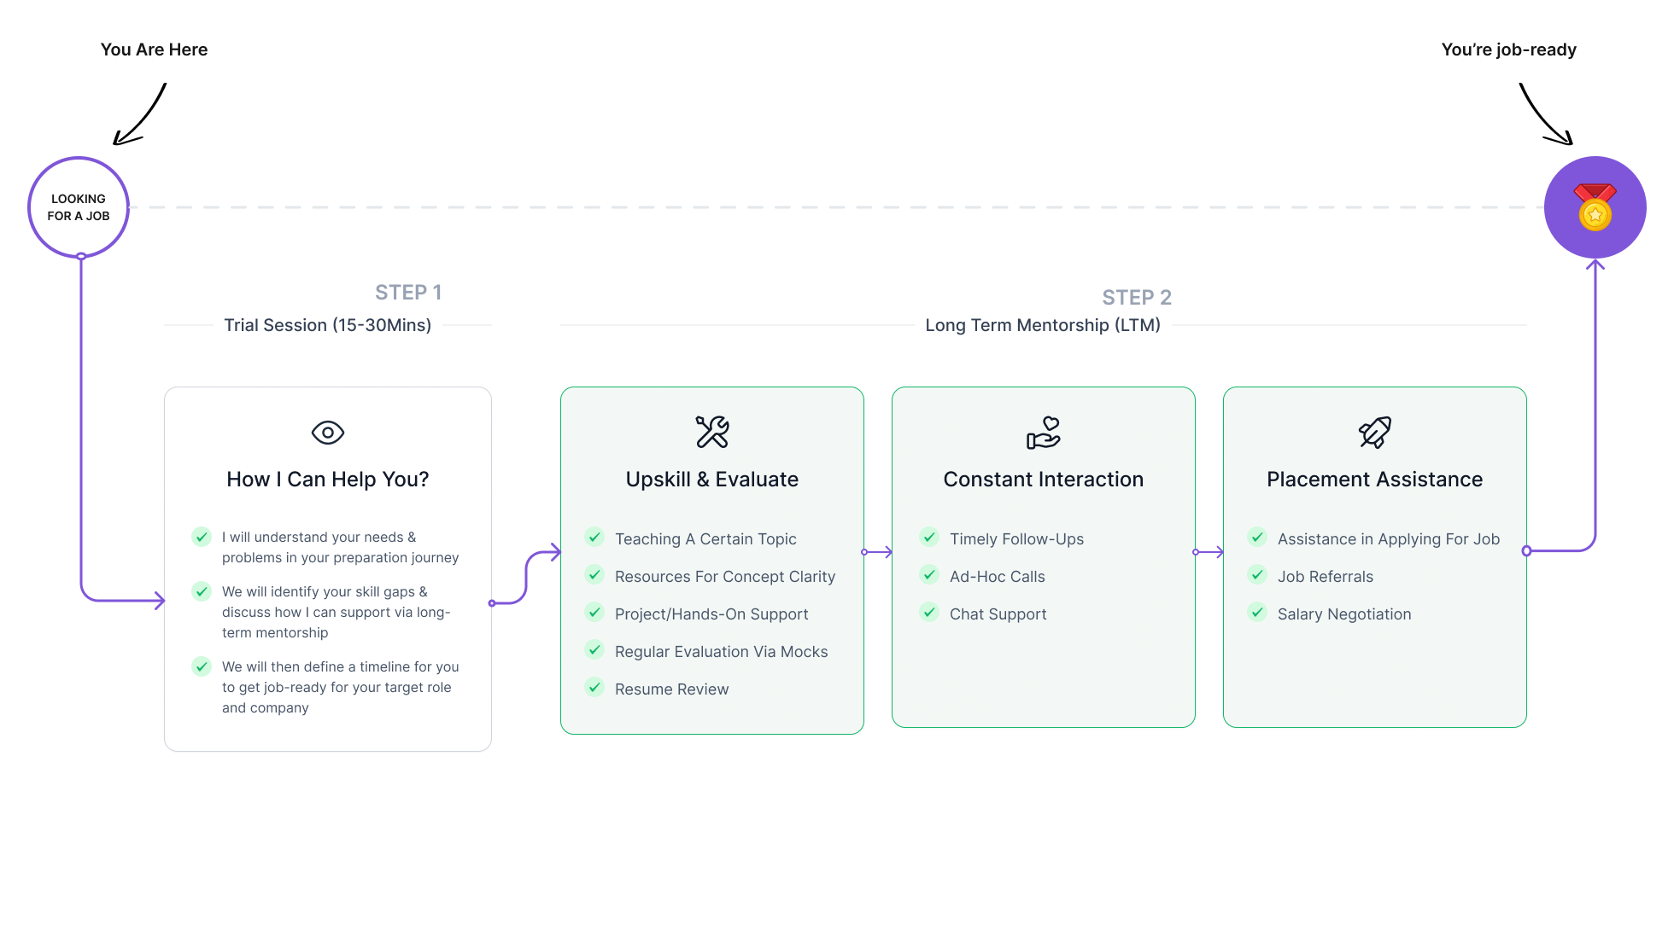
HOW DO I HELP IN 1:1 LONG TERM MENTORSHIP?

Slide 21

BOOK A FREE 1:1 TRIAL SESSION
Visit app.preplaced.in
Search Simran Bansal
Book a Free Trial Session

Slide 22


